Slide 1
GAMES103: Intro to Physics-Based Animation
Constraint Approaches
Huamin Wang
Nov 2021

Slide 2
Topics for the Day
Strain Limiting and Position Based Dynamics
Projective Dynamics
Constrained Dynamics

Slide 3
Strain Limiting and Position Based Dynamics

Slide 4
The Stiffness Issue
Real-world fabrics resist strongly to stretching, once they stretch beyond certain limits.
But, increasing the stiffness can cause problems.
Explicit integrators will be unstable
Solution: smaller time steps and more computational time.
The linear systems involved in Implicit integrators will be ill-conditioned.
Solution: more iterations and computational time.
Can we achieve high stiffness, with a low computational cost?

Slide 5

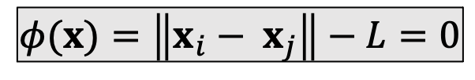
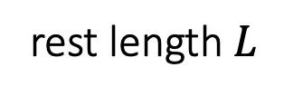


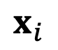
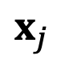

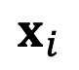
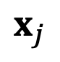
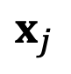
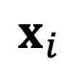
A Single Spring
If a spring is infinitely stiff, we can treat the length as a constraint and define a projection function.
$$x_{j}$$
rest length $L$
$$x_{i}^{new}$$
$$x_{j}^{new}$$
$$x_{i}$$
$$x_{i}$$
$$x_{j}$$
$$x_{j}$$
$$x_{j}^{new}$$
$$φ(x)=\left\|x_{i}− x_{j}\right\|−L=0$$
$$x_{i}^{new}$$
Constraint
$$x_{i}$$
Stretched case
Compressed Case

Slide 6
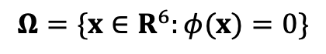
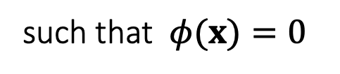
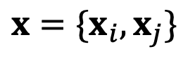

A Single Spring
If a spring is infinitely stiff, we can treat the length as a constraint and define a projection function.
$$\left\{x_{i}^{new},x_{j}^{new}\right\}=argmin\frac{1}{2}\left\{{m_{i}\left\|x_{i}^{new}−x_{i}\right\|}^{2}+{m_{j}\left\|x_{j}^{new}−x_{j}\right\|}^{2}\right\}$$
such that $φ(x)=0$
rest length $L$
$$x_{i}$$
$$x_{j}$$
$${x=\{x}_{i},x_{j}\}$$
$$φ(x)=\left\|x_{i}− x_{j}\right\|−L=0$$
Boundary $∂Ω$
Constraint
$$Ω=\{x∈R^{6}:φ(x)=0\}$$

Slide 7
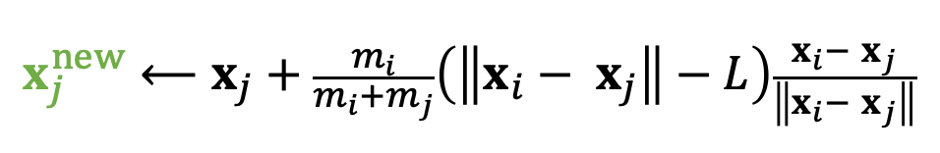
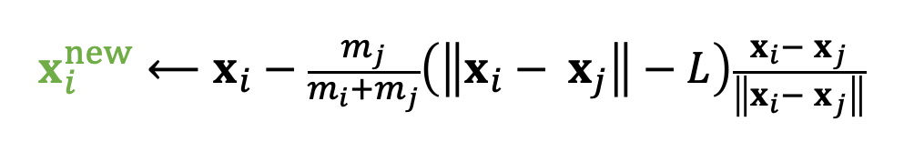

A Single Spring
If a spring is infinitely stiff, we can treat the length as a constraint and define a projection function.
$$\left\{x_{i}^{new},x_{j}^{new}\right\}=argmin\frac{1}{2}\left\{{m_{i}\left\|x_{i}^{new}−x_{i}\right\|}^{2}+{m_{j}\left\|x_{j}^{new}−x_{j}\right\|}^{2}\right\}$$
such that $φ(x)=0$
rest length $L$
$$x_{i}$$
$$x_{j}$$
$$x^{new}⟵Projection(x)$$
$$φ(x)=\left\|x_{i}− x_{j}\right\|−L=0$$
$$x_{i}^{new}⟵x_{i}−\frac{m_{j}}{m_{i}+m_{j}}\left(\left\|x_{i}− x_{j}\right\|−L\right)\frac{x_{i}− x_{j}}{\left\|x_{i}− x_{j}\right\|}$$
Constraint
$$x_{j}^{new}⟵x_{j}+\frac{m_{i}}{m_{i}+m_{j}}\left(\left\|x_{i}− x_{j}\right\|−L\right)\frac{x_{i}− x_{j}}{\left\|x_{i}− x_{j}\right\|}$$
$$φ\left(x^{new}\right)=\left\|x_{i}^{new}− x_{j}^{new}\right\|−L=\left\|x_{i}−x_{j}−x_{i}+x_{j}+L\right\|−L=0$$
By default, $m_{i}=m_{j}$, but we can also set $m_{i}=∞$ for stationary nodes.

Slide 8
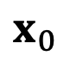
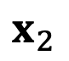
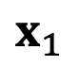
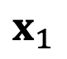
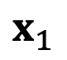
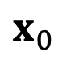
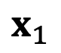
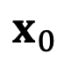
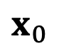
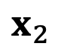
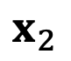
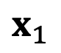
Multiple Springs – A Gauss-Seidel Approach
What about multiple springs? The Gauss-Seidel approach projects each spring sequentially in a certain order. Imagine two springs with unit rest lengths…
$$x_{0}$$
$$x_{0}$$
$$x_{0}$$
2
1
$$x_{0}$$
$$x_{0}$$
$$x_{1}$$
1.75
1
1.1875
$$x_{1}$$
$$x_{1}$$
$$x_{1}$$
$$x_{1}$$
1.375
1
2.5
1
2
$$x_{2}$$
$$x_{2}$$
$$x_{2}$$
$$x_{2}$$
$$x_{2}$$

Slide 9



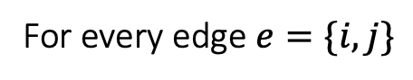
Multiple Springs – A Gauss-Seidel Approach
Projection (by Gauss-Seidel)
For $k=0…K$
For every edge $e=\{i,j\}$
$$x_{i}⟵x_{i}−\frac{1}{2}\left(\left\|x_{i}− x_{j}\right\|−L_{e}\right)\frac{x_{i}− x_{j}}{\left\|x_{i}− x_{j}\right\|}$$
$$x_{j}⟵x_{j}+\frac{1}{2}\left(\left\|x_{i}− x_{j}\right\|−L_{e}\right)\frac{x_{i}− x_{j}}{\left\|x_{i}− x_{j}\right\|}$$
We cannot ensure the satisfaction of every constraint. But the more iterations we use, the better those constraints are satisfied.
Although the name is related to Gauss-Seidel, it differs from Gauss-Seidel. It is more relevant to stochastic gradient descent (in machine learning).
The order matters. The order can cause bias and affect convergence behavior.

Slide 10
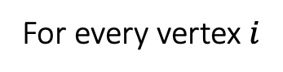
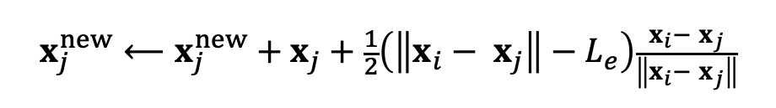
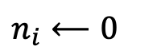
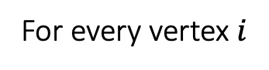
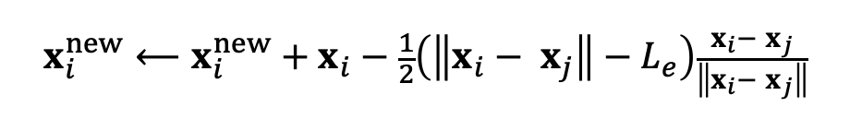
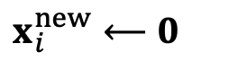
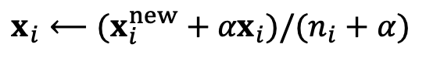

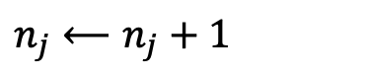
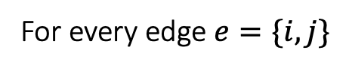
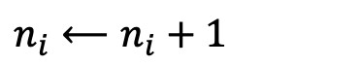
Multiple Springs – A Jacobi Approach
Projection (by Jacobi)
To avoid bias, the Jacobi approach projects all of the edges simultaneously and then linearly blend the results.
The problem is an even lower convergence rate.
Again, the more iterations it uses, the better the constraints are enforced.
For $k=0…K$
For every vertex $i$
$$x_{i}^{new}⟵0$$
$$n_{i}⟵0$$
For every edge $e=\{i,j\}$
$$x_{i}^{new}⟵x_{i}^{new}+x_{i}−\frac{1}{2}\left(\left\|x_{i}− x_{j}\right\|−L_{e}\right)\frac{x_{i}− x_{j}}{\left\|x_{i}− x_{j}\right\|}$$
$$x_{j}^{new}⟵x_{j}^{new}+x_{j}+\frac{1}{2}\left(\left\|x_{i}− x_{j}\right\|−L_{e}\right)\frac{x_{i}− x_{j}}{\left\|x_{i}− x_{j}\right\|}$$
$$n_{i}⟵n_{i}+1$$
$$n_{j}⟵n_{j}+1$$
For every vertex $i$
$$x_{i}⟵(x_{i}^{new}+{αx}_{i})/(n_{i}+α)$$

Slide 11
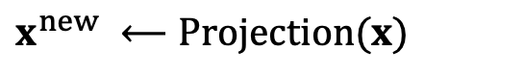
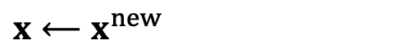
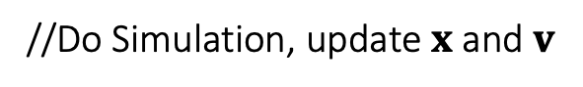
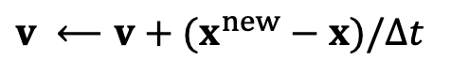
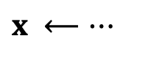
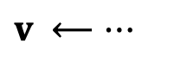
Position Based Dynamics (PBD)
Position based dynamics (PBD) is based on the projection function.
The stiffness behavior, i.e., how tightly constraints are enforced, is subject to non-physical factors.
The number of iterations
The mesh resolution
The velocity update following projection is important to dynamic effects.
This method is applicable to other constraints as well, including triangle constraints, volume constraints, and collision constraints.
To implement these constraints, simply define their projection functions.
A PBD Simulator
//Do Simulation, update $x$ and $v$
$$v ⟵…$$
$$x ⟵…$$
//Now PBD starts.
$$x^{new} ⟵Projection(x)$$
$$v ⟵v+(x^{new}−x)/∆t$$
$$x⟵x^{new}$$

Slide 12

Pros and Cons of PBD
Pros
Parallelable on GPUs (PhysX)
Easy to implement
Fast in low resolutions
Generic, can handle other coupling and constraints, including fluids
Cons
Not physically correct
Low performance in high resolutions
Hierarchical approaches (can cause oscillation and other issues…)
Acceleration approaches, like Chebyshev

Slide 13
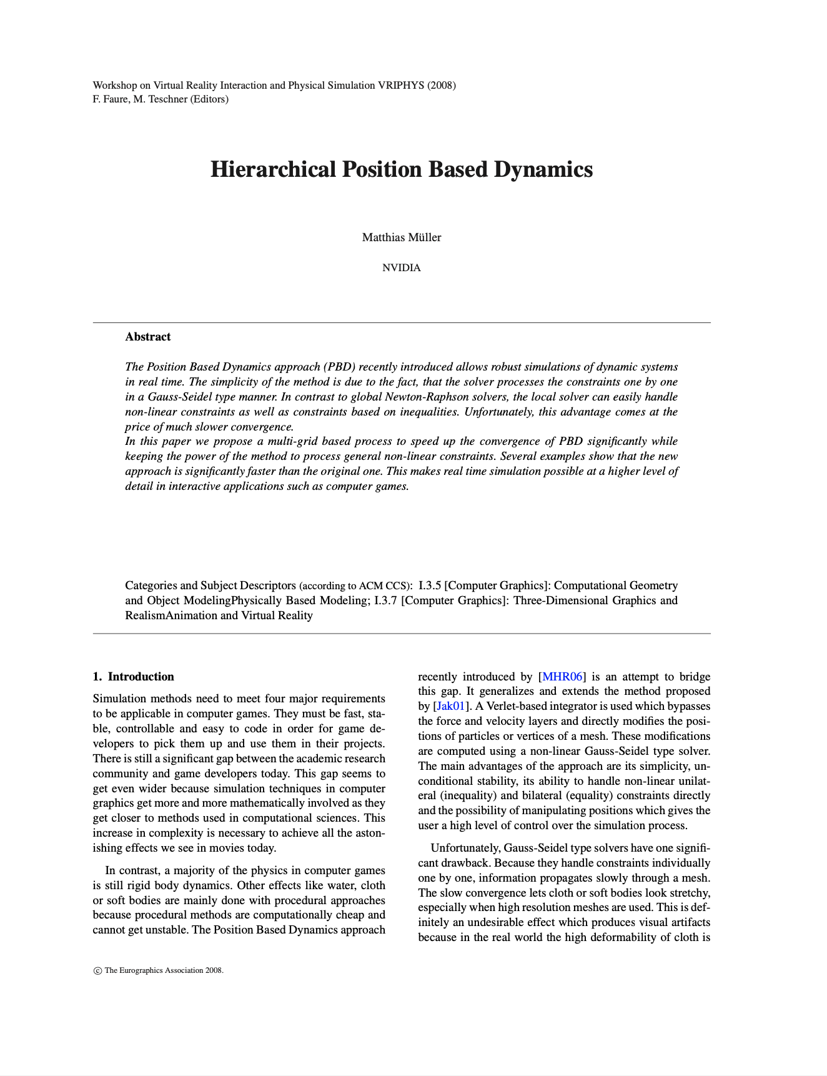
After-Class Reading
Muller. 2008. Hierarchical Position Based Dynamics. VRIPHYS.

Slide 14
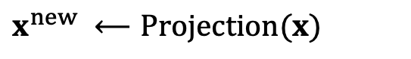
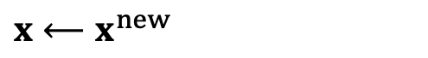
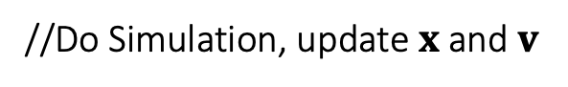
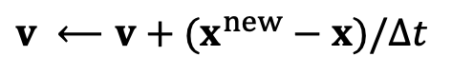
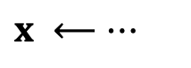
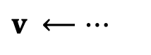
Strain Limiting
Strain limiting aims at using the projection function for correction only.
A Simulator with Strain Limiting
//Do Simulation, update $x$ and $v$
Still do some dynamics
$$v ⟵…$$
$$x ⟵…$$
//Now strain limiting starts.
$$x^{new} ⟵Projection(x)$$
$$v ⟵v+(x^{new}−x)/∆t$$
$$x⟵x^{new}$$

Slide 15

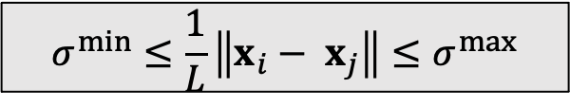







Spring Strain Limit
We can set the spring strain, i.e., the stretching ratio $σ$, to be within a limit.
$$x_{j}$$
$$x_{j}^{new}$$
rest length $L$
$$L$$
$$x_{i}^{new}$$
$$x_{i}$$
$$x_{j}$$
$$x_{i}$$
$$x_{j}$$
$$x_{j}^{new}$$
$$σ^{min}≤\frac{1}{L}\left\|x_{i}− x_{j}\right\|≤σ^{max}$$
$$x_{i}^{new}$$
Constraint
$$x_{i}$$
Stretched case
Compressed Case

Slide 16







Spring Strain Limit
We can set the spring strain, i.e., the stretching ratio $σ$, to be within a limit.
$$x^{new}⟵Projection(x)$$
$$σ⟵\frac{1}{L}\left\|x_{i}− x_{j}\right\|$$
rest length $L$
$$x_{i}$$
$$x_{j}$$
$$σ_{0}⟵min\left(\max\left(σ,σ^{min}\right),σ^{max}\right)$$
$$x_{i}^{new}⟵x_{i}−\frac{m_{j}}{m_{i}+m_{j}}\left(\left\|x_{i}− x_{j}\right\|−σ_{0}L\right)\frac{x_{i}− x_{j}}{\left\|x_{i}− x_{j}\right\|}$$
$$σ^{min}≤\frac{1}{L}\left\|x_{i}− x_{j}\right\|≤σ^{max}$$
$$x_{j}^{new}⟵x_{j}+\frac{m_{j}}{m_{i}+m_{j}}\left(\left\|x_{i}− x_{j}\right\|−σ_{0}L\right)\frac{x_{i}− x_{j}}{\left\|x_{i}− x_{j}\right\|}$$
Constraint
PBD: $σ_{0}≡1$;
No limit: ${σ^{min}, σ}^{max}⟵∞$

Slide 17











Triangle Area Limit
We can limit the triangle area as well. To do so, we define a scaling factor.
$$\left\{x_{i}^{new},x_{i}^{new},x_{k}^{new}\right\} = argmin\frac{1}{2}\left\{{m_{i}\left\|x_{i}^{new}−x_{i}\right\|}^{2}+{m_{j}\left\|x_{j}^{new}−x_{j}\right\|}^{2}+{m_{j}\left\|x_{k}^{new}−x_{k}\right\|}^{2}\right\}$$
such that the constraint is satisfied.
$$x_{k}$$
$$x_{k}^{new}$$
$s=$ $\sqrt{min\left(\max\left(A,A^{min}\right),A^{max}\right)/A}$
Scaling by $s$
Area $s^{2}A$
Area $A$
$$x_{j}^{new}$$
$$x_{j}$$
$$x_{i}^{new}$$
$$x_{i}$$
$$A^{min}≤A≤A^{max}$$
Constraint

Slide 18







Triangle Area Limit
To limit the area, we use the fact that the mass center doesn’t move.
$$\left\{x_{i}^{new},x_{i}^{new},x_{k}^{new}\right\} = argmin\frac{1}{2}\left\{{m_{i}\left\|x_{i}^{new}−x_{i}\right\|}^{2}+{m_{j}\left\|x_{j}^{new}−x_{i}\right\|}^{2}+{m_{j}\left\|x_{j}^{new}−x_{i}\right\|}^{2}\right\}$$
such that the constraint is satisfied.
$$x_{k}$$
$$x^{new}⟵Projection(x)$$
$$A⟵\frac{1}{2}\left\|\left(x_{j}− x_{i}\right)×\left(x_{k}− x_{i}\right)\right\|$$
$$s⟵\sqrt{min\left(\max\left(A,A^{min}\right),A^{max}\right)/A}$$
Area $A$
$$c⟵\frac{1}{m_{i}+m_{j}+m_{k}}\left(m_{i}x_{i}+m_{j}x_{j}+m_{k}x_{k}\right)$$
$$x_{j}$$
$$x_{i}^{new}⟵c+s\left(x_{i}−c\right)$$
$$x_{j}^{new}⟵c+s\left(x_{j}−c\right)$$
$$x_{i}$$
$$A^{min}≤A≤A^{max}$$
$$x_{k}^{new}⟵c+s\left(x_{k}−c\right)$$
Constraint

Slide 19
Strain Limiting in Simulation
Strain limiting is widely used in physics-based simulation, typically for avoiding instability and artifacts due to large deformation.
Strain limiting is useful for nonlinear effects, in a biphasic way.
Strain limiting also helps address the locking issue.
Phase 1:
Elastic Model
Phase 2:
Strain Limiting
Force
Strain (deformation)

Slide 20

After-Class Reading (optional)
Provot. 1995. Deformation Constraints in a Mass-Spring Model to Describe Rigid Cloth Behavior. Graphics Interface.

Slide 21
Projective Dynamics

Slide 22




Projective Dynamics
Instead of blending projections in a Jacobi or Gauss-Seidel fashion as in PBD, projective dynamics uses projection to define a quadratic energy.
$$E(x)=\sum_{e=\{i,j\}}{{\frac{1}{2}\left\|\left(x_{i}−x_{j}\right)−(x_{e,i}^{new}−x_{e,j}^{new})\right\|}^{2}}$$
$$x_{i}$$
$$e$$
$$x_{j}$$
$\left\{x_{e,i}^{new},x_{e,j}^{new}\right\}=Projection_{e}(x_{i},x_{j})$ for every edge $e$
$$f_{i}=−∇_{i}E\left(x\right)=−\sum_{e:i∈e}{\left(x_{i}−x_{j}\right)−(x_{e,i}^{new}−x_{e,j}^{new})}$$

Slide 23











Projective Dynamics – Explained
Instead of blending projections in a Jacobi or Gauss-Seidel fashion as in PBD, projective dynamics uses projection to define a quadratic energy.
$$E\left(x\right)= \frac{1}{2}{\left\|\left(x_{0}−x_{1}\right)−\left(x_{0,0}^{new}−x_{0,1}^{new}\right)\right\|}^{2}+\frac{1}{2}{\left\|\left(x_{0}−x_{2}\right)−\left(x_{1,0}^{new}−x_{1,2}^{new}\right)\right\|}^{2}+$$
$$\frac{1}{2}{\left\|\left(x_{0}−x_{3}\right)−\left(x_{2,0}^{new}−x_{2,3}^{new}\right)\right\|}^{2}+\frac{1}{2}{\left\|\left(x_{1}−x_{2}\right)−\left(x_{3,1}^{new}−x_{3,2}^{new}\right)\right\|}^{2}+$$
$$x_{0}$$
$$e_{0}$$
$$x_{1}$$
$$\frac{1}{2}{\left\|\left(x_{2}−x_{3}\right)−\left(x_{4,2}^{new}−x_{4,3}^{new}\right)\right\|}^{2}$$
$$e_{2}$$
$$e_{1}$$
$$f_{0}=\left(x_{0,0}^{new}−x_{0,1}^{new}\right)−\left(x_{0}−x_{1}\right)+\left(x_{1,0}^{new}−x_{1,2}^{new}\right)−\left(x_{0}−x_{2}\right)+$$
$$x_{3}$$
$$e_{3}$$
$$\left(x_{2,0}^{new}−x_{2,3}^{new}\right)−\left(x_{0}−x_{3}\right)$$
$$e_{4}$$
$$H=\left[\begin{matrix}3I & −I & −I & −I \\ −I & 2I & −I & \\ −I & −I & 3I & −I \\ −I & & −I & 2I\end{matrix} \right]$$
$$x_{2}$$

Slide 24









Projective Dynamics – Shape Matching
Shape matching is also projective dynamics, if we view rotation as projection:
$$E\left(x\right) ={\frac{1}{2}\left\|\left[\begin{matrix}x_{1}−x_{0} & x_{2}−x_{0}\end{matrix}\right]{\left[\begin{matrix}r_{1}−r_{0} & r_{2}−r_{0}\end{matrix}\right]}^{−1}−R \right\|}^{2}$$
$$x_{2}$$
projection
Assuming that $R$ is constant,
$$x_{2}−x_{0}$$
$$f_{0}=−∇_{0}E\left(x\right)$$
$$f_{1}=−∇_{1}E\left(x\right)$$
$$r_{2}−r_{0}$$
$$x_{1}$$
$$f_{2}=−∇_{2}E\left(x\right)$$
$H=\frac{{∂E}^{2}\left(x\right)}{∂x^{2}}$ is a constant!
$$x_{1}−x_{0}$$
$$r_{1}−r_{0}$$
The 2D Space
The 3D Space
$$x_{0}$$

Slide 25






Simulation by Projective Dynamics
According to implicit integration and Newton’s method, a projective dynamics simulator looks as follows, with matrix $A=\frac{1}{∆t^{2}}M+H$ being constant.
We can use a direct solver with only one factorization of $A$.
Initialize $x^{\left(0\right)}$, often as $x^{\left[0\right]}$ or $x^{\left[0\right]}$ $+{∆tv}^{\left[0\right]}$
For $k=0…K$
Recalculate projection
$$\left(\frac{1}{∆t^{2}}M+H\right)∆x=− \frac{1}{∆t^{2}}M\left({x^{\left(k\right)}−x}^{\left[0\right]}−{∆tv}^{\left[0\right]}\right)+f\left(x^{\left(k\right)}\right)$$
Solve
$$x^{\left(k+1\right)}←x^{\left(k\right)}+∆x$$
If $\left\|∆x\right\|$ is small then break
$$x^{\left[1\right]}←x^{\left(k+1\right)}$$
$v^{\left[1\right]}←\left(x^{\left[1\right]}−x^{\left[0\right]}\right)/$ $∆t$
“Newton’s Method”

Slide 26



Preconditioned Steepest Descent
Mathematically, this approach is preconditioned steepest descent, in which:
$$\left(\frac{1}{∆t^{2}}M+H\right)∆x=− \frac{1}{∆t^{2}}M\left({x^{\left(k\right)}−x}^{\left[0\right]}−{∆tv}^{\left[0\right]}\right)+f\left(x^{\left(k\right)}\right)$$
preconditioner
negative gradient of $F\left(x\right)$
$$F\left(x\right)=\frac{1}{2∆t^{2}}{\left\|x−x^{\left[0\right]}−{∆tv}^{\left[0\right]}\right\|}_{M}^{2}+E(x)$$
The performance depends on how well $H$ approximates the real Hessian.

Slide 27

Pros and Cons of Projective Dynamics
By building constraints into energy, the simulation now has a theoretical solution with physical meaning.
Fast on CPUs with a direct solver. No more factorization!
Fast convergence in the first few iterations.
Slow on GPUs. (GPUs don’t support direct solver wells.)
Slow convergence over time, as it fails to consider Hessian caused by projection.
Still suffering from high stiffness
Cannot easily handle constraint changes.
Contacts
Remeshing due to fracture, etc.
Projective dynamics

Slide 28

After-Class Reading
Bouaziz et al. 2014. Projective Dynamics: Fusing Constraint Projections for Fast Simulation. TOG (SIGGRAPH).

Slide 29
Constrained Dynamics

Slide 30










Constrained Dynamics
A critical problem exists: what if constraints/forces are very very stiff? Or infinitely stiff?
$$E(x)=\sum_{e}{{\frac{1}{2}k\left(\left\|x_{ei} −x_{ej} \right\|−L_{e}\right)}^{2}}=\frac{1}{2}φ^{T}\left(x\right)C^{−1}φ\left(x\right)$$
rest length $L_{e}$
$$f\left(x\right)=−∇E=−{\left(\frac{∂E}{∂φ} \frac{∂φ}{∂x}\right)}^{T}=−J^{T}C^{−1}φ=J^{T}λ$$
$$x_{ei}$$
$$x_{ej}$$
Let N be the number of vertices and E be the number of constraints,
$C=\left[\begin{matrix}1/k & & \\ & 1/k & \\ & & ⋱\end{matrix}\right]$ $∈R^{E×E}$
$$φ_{e}(x)=\left\|x_{ei}− x_{ej}\right\|−L_{e}$$
$$φ\left(x\right)∈R^{E}$$
Compliant constraint
Compliant matrix
$$J=\frac{∂φ}{∂x}∈R^{E×3N}$$
$λ=−C^{−1}φ$ $∈R^{E}$
Jacobian
Dual variables (Lagrangian multipliers)

Slide 31


Constrained Dynamics
A critical problem exists: what if constraints/forces are very very stiff? Or infinitely stiff?
$$E(x)=\sum_{e}{{\frac{1}{2}k\left(\left\|x_{ei} −x_{ej} \right\|−L_{e}\right)}^{2}}=\frac{1}{2}φ^{T}\left(x\right)C^{−1}φ\left(x\right)$$
rest length $L_{e}$
$$f\left(x\right)=−∇E=−{\left(\frac{∂E}{∂φ} \frac{∂φ}{∂x}\right)}^{T}=−J^{T}C^{−1}φ=J^{T}λ$$
$$x_{ei}$$
$$x_{ej}$$
By implicit integration, we get:
$Mv^{new}−∆t$ $J^{T}λ^{new}=Mv$
$$φ_{e}(x)=\left\|x_{ei}− x_{ej}\right\|−L_{e}$$
Meanwhile,
Compliant constraint
${Cλ}^{new}=−φ^{new}≈−φ−J\left(x^{new}−x\right)≈−φ−∆tJ$ $v^{new}$
$$\left[\begin{matrix}M & −∆t J^{T} \\ ∆tJ & C\end{matrix}\right]\left[\begin{aligned}v^{new} \\ λ^{new}\end{aligned}\right]=\left[\begin{aligned}Mv \\ −φ\end{aligned}\right]$$

Slide 32



Constrained Dynamics
Now we have a system with two sets of variables: the primal variable $x$ (or $v=\dot{x}$) and the dual variable $λ$.
Method 1: We can solve the two variables by a direct solver together, in a primal-dual fashion:
Method 2: We can reduce the system by Schur complement and solve $λ^{new}$ first.
Infinite stiffness? $C⟶0$.
$$\left[\begin{matrix}M & −∆t J^{T} \\ ∆tJ & C\end{matrix}\right]\left[\begin{aligned}v^{new} \\ λ^{new}\end{aligned}\right]=\left[\begin{aligned}Mv \\ −φ\end{aligned}\right]$$
$$\left(∆t^{2}JM^{−1}J^{T}+C\right)λ^{new}=−φ−∆tJv$$
$$v^{new}⟵v+−∆tM^{−1}J^{T}λ^{new}$$

Slide 33
Constrained Dynamics
Articulated Rigid Bodies (ragdoll animation)

Slide 34





Stable Constrained Dynamics
From a mass-spring system, we know spring Hessian (tangent stiffness) is:
$$H\left(x\right)=\sum_{e=\{i,j\}}{\left[\begin{matrix} & & & \\ & H_{e} & −H_{e} & \\ & −H_{e} & H_{e} & \\ & & & \end{matrix}\right]}$$
$H_{e}=$ $k\frac{x_{ij}x_{ij}^{T}}{{\left\|x_{ij}\right\|}^{2}}+k\left(1−\frac{L}{\left\|x_{ij}\right\|}\right)\left(I−\frac{x_{ij}x_{ij}^{T}}{{\left\|x_{ij}\right\|}^{2}}\right)$
material stiffness
geometric stiffness
According to constrained dynamics: $f\left(x\right)=J^{T}λ$ and $λ=−C^{−1}φ$, so:
$$H\left(x\right)=−\frac{∂f}{∂x}=J^{T}C^{−1}J−\frac{∂J^{T}}{∂x}λ=\sum_{e=\left\{i,j\right\}}{{kJ}_{e}^{T}J_{e}}+\sum_{e=\left\{i,j\right\}}{\frac{∂J_{e}^{T}}{∂x}λ_{e}}$$
$$J_{e}=\frac{{∂φ}_{e}}{∂x}=\left[\begin{matrix} & \frac{x_{ij}^{T}}{\left\|x_{ij}\right\|} & −\frac{x_{ij}^{T}}{\left\|x_{ij}\right\|} & \end{matrix}\right]$$

Slide 35



Stable Constrained Dynamics
According Lecture 5, Page 16, implicit integration is:
$$\left(\frac{1}{∆t^{2}}M+H\left(x^{[0]}\right)\right)∆x= \frac{1}{∆t^{2}}M\left({∆tv}^{\left[0\right]}\right)+f\left(x^{[0]}\right)$$
$$\left(M+∆t^{2}H\left(x^{[0]}\right)\right)v^{new}= Mv^{\left[0\right]}+∆tf\left(x^{[0]}\right)$$
But implicit integration with constrained dynamics is:
$$\left[\begin{matrix}M & −∆t J^{T} \\ ∆tJ & C\end{matrix}\right]\left[\begin{aligned}v^{new} \\ λ^{new}\end{aligned}\right]=\left[\begin{aligned}Mv \\ −φ\end{aligned}\right]$$
$$\left(M+∆t^{2}J^{T}C^{−1}J\right)v^{new}=Mv−∆t J^{T}C^{−1}φ=Mv+∆tf$$
material stiffness
Missing geometric stiffness matrix here…

Slide 36


After-Class Reading (optional)
geometric stiffness
$$\left[\begin{matrix}M−∆t^{2}\frac{∂J^{T}}{∂x}λ & −∆t J^{T} \\ ∆tJ & C\end{matrix}\right]\left[\begin{aligned}v^{new} \\ λ^{new}\end{aligned}\right]=\left[\begin{aligned}Mv \\ −φ\end{aligned}\right]$$
Tournier et al. 2015. Stable Constrained Dynamics. TOG (SIGGRAPH).

Slide 37
A Summary For the Day
Position-based dynamics and strain limiting
The key is to build a projection function for every constraint.
Two approaches for integration: Jacobi and Gauss-Seidel.
Fast in low resolutions, but problematic in high resolutions.
Not physically correct.
Projective Dynamics
Also uses projection functions, but they are now built into energies.
In every iteration, projections are first updated, and then treated as constants in implicit formulation.
The matrix in the system becomes constant, can be pre-factorized for fast simulation.
Converges fast only in the first few iterations, slow afterwards. CPU friendly.
Constrained Dynamics
Focused on very stiff constraints. Introduces dual variables.
Also built upon implicit integration. Two methods: primal-dual, pure dual.
Restrictions on the solvers.

